Slide 1
The String Class
Unit 2.2 Using Objects

Slide 2
Overview
char VS String
Index
String length
String Concatenation
Comparing strings
substring
Mutable VS Immutable
Escape Sequences
toString()

Slide 3
Char VS String
char
String
char is a primitive datatype
used to store a single character.
The character must be surrounded by single quotes.
String is a reference type
can be a single character or group of characters like a word or sentence
can be created by simply declaring a String variable like a primitive
Also can be created by using the constructor from the String class

Slide 4
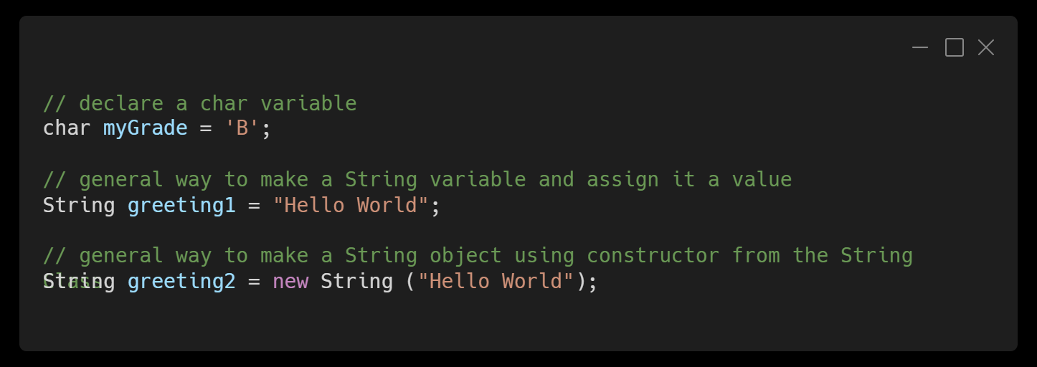
The String Object

Slide 5
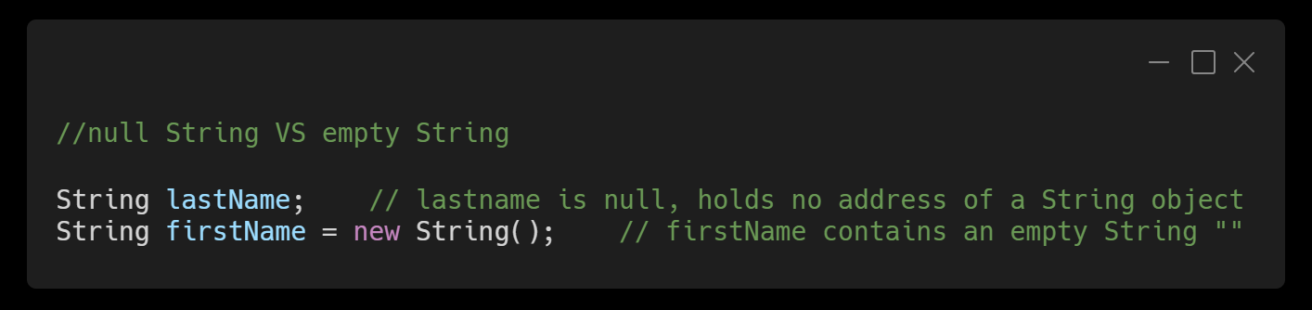
Null String VS empty String

Slide 6
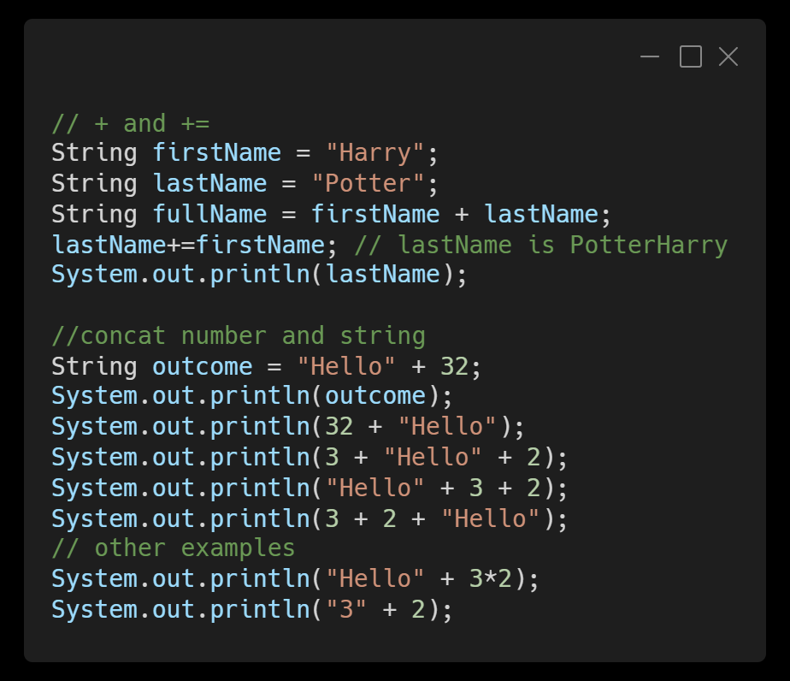
String Concatenation

Slide 7
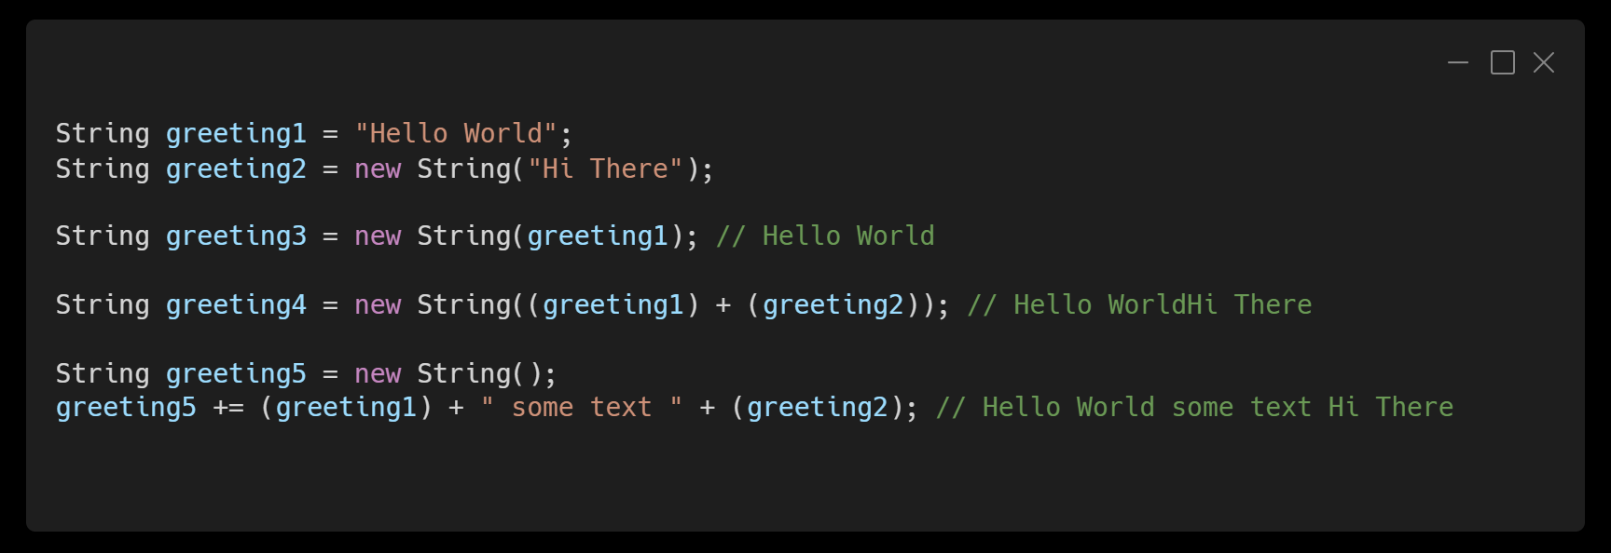
String Concatenation
+= join and redefine

Slide 8
Index
String myDessert = “ice cream”;
i | c | e |  | c | r | e | a | m
0 | 1 | 2 | 3 | 4 | 5 | 6 | 7 | 8
First character's index : 0
Last character's index : the string's length - 1

Slide 9
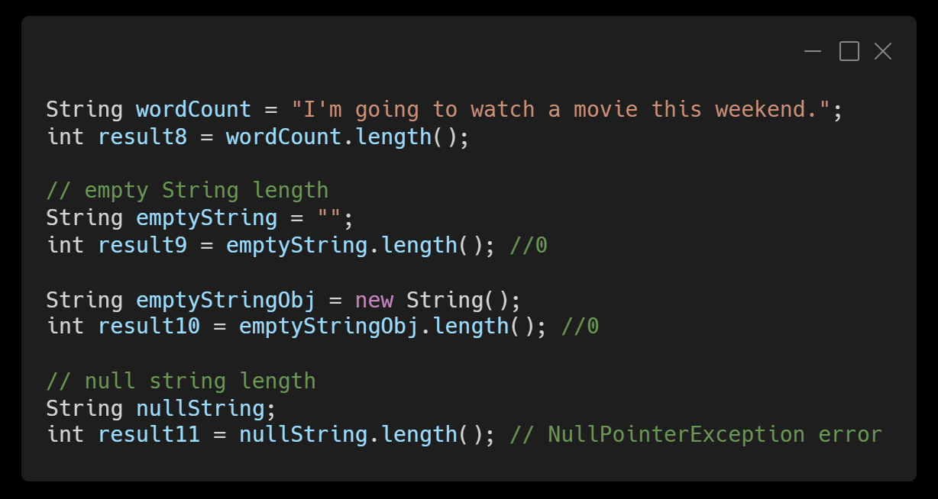
The length() Method

Slide 10
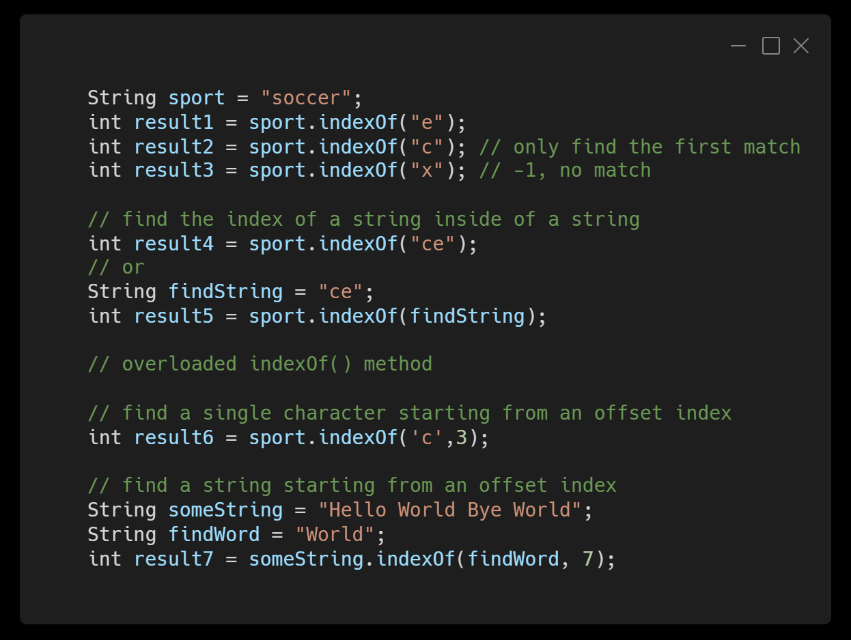
indexOf()

Slide 11
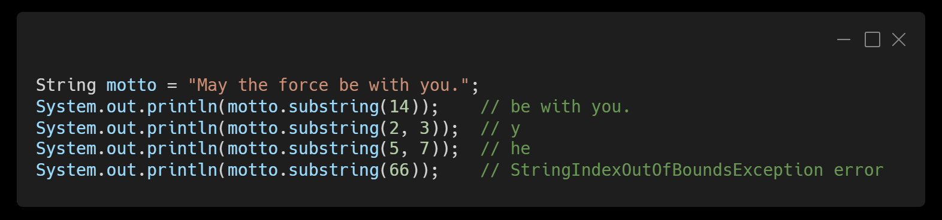
The substring() Method
substring(int index)
substring(int firstIndex, int secondIndex)
Start extracting at index and stops when it reaches the last character
Start extracting at firstIndex and stops at secondIndex – 1 (up to but not include the secondIndex)

Slide 12
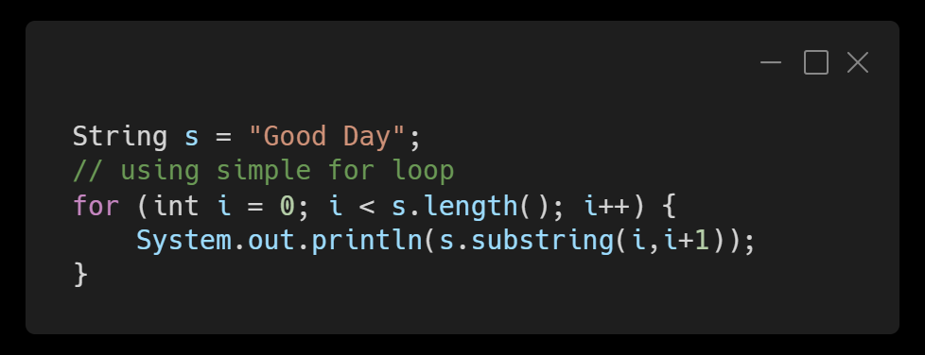
Traverse a string

Slide 13
Compare String Objects
The equals() Method
The compareTo() Method
to test if two strings have the same characters in the same order
return a boolean true if the two strings are identical
return false if the two strings differ in any way
case-sensitive
return 0, if the two strings are the same
return negative values, if the first string comes before(less than) the second string
return positive values, if the first string comes after(greater than) the second string
Uppercase letters comes before their lowercase counterparts

Slide 14
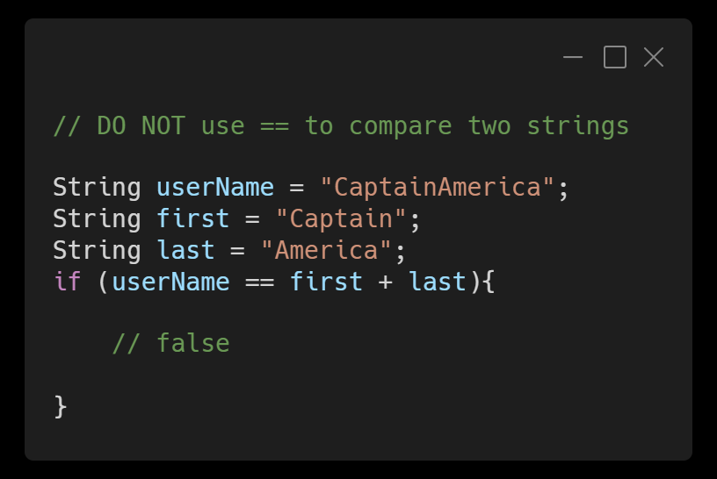
equals VS ==
When comparing two strings using ==, it only compares whether or not the two String references point to the same object!

Slide 15
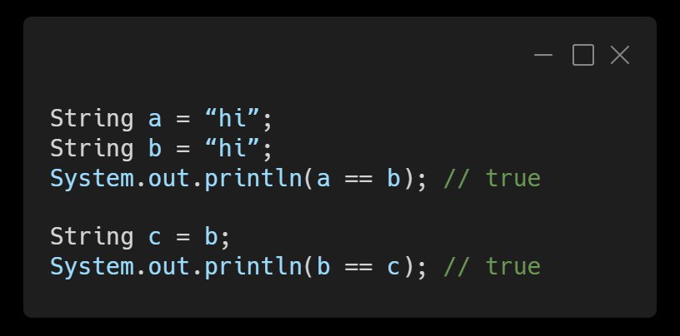
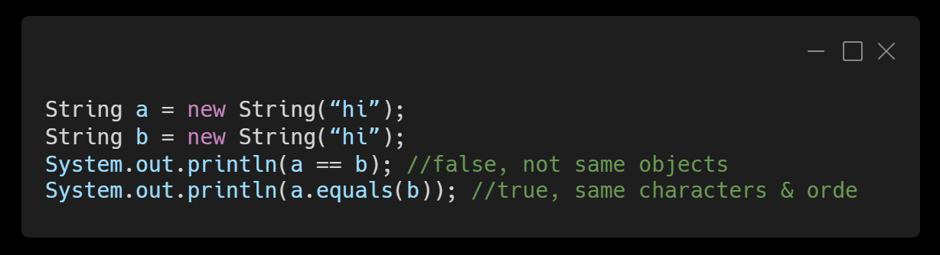
Java run-time will check if that string literal already exists as an object in memory.

Slide 16
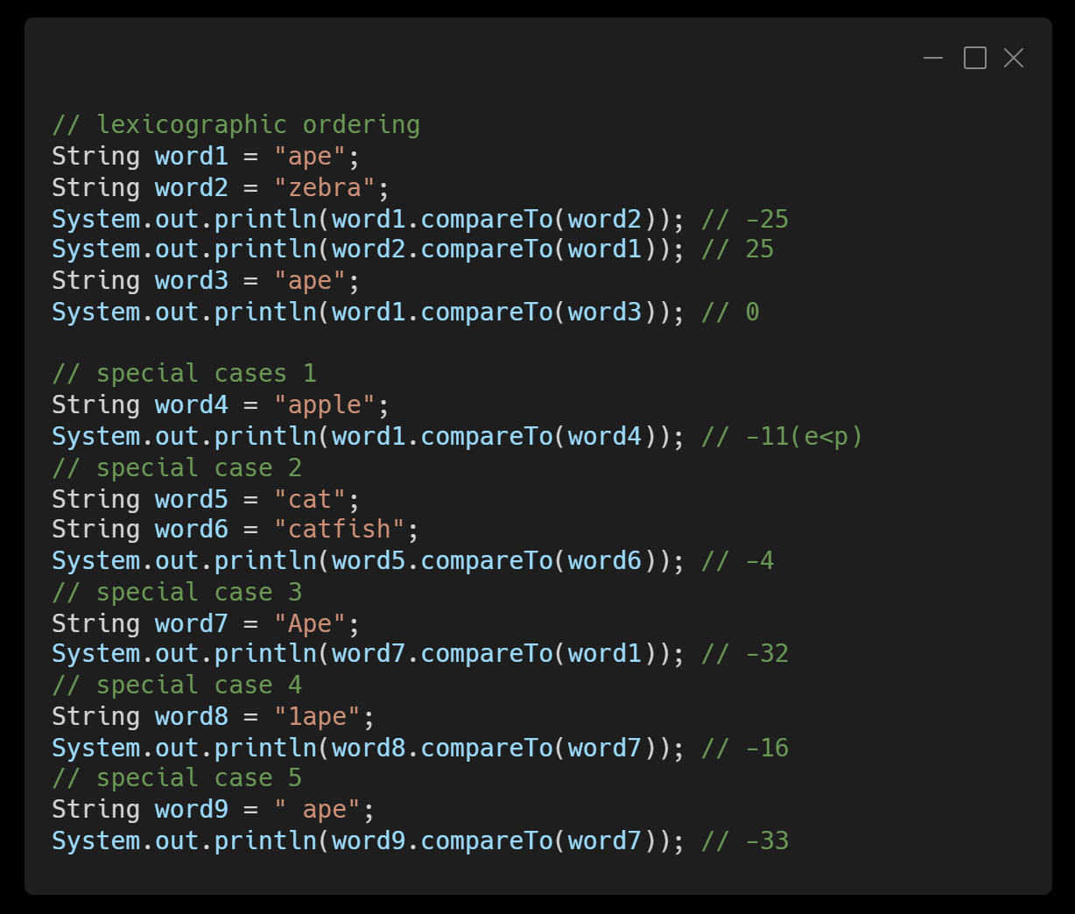
compareTo()

Slide 17
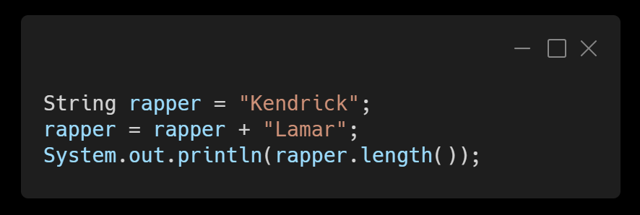
Immutable VS Mutable
String is immutable:
Every time you make a change to a String variable, Java actually tosses out the old one and creates a new one and that’s what you end up referencing. In another words, once created, its value cannot be changed in place. To modify a variable's value, you must reassign it

Slide 18
Escape Sequences
Purpose | Sequence | Example | Output
Include a double quote | \" | "\"OMG\" " | "OMG"
Tab | \t | "a\tb\tc" | a b c
New line | \n | "a\nb\nc" | a b c
backslash | \\ | "I am a backslash: \\" | I am a backslash: \

Slide 19
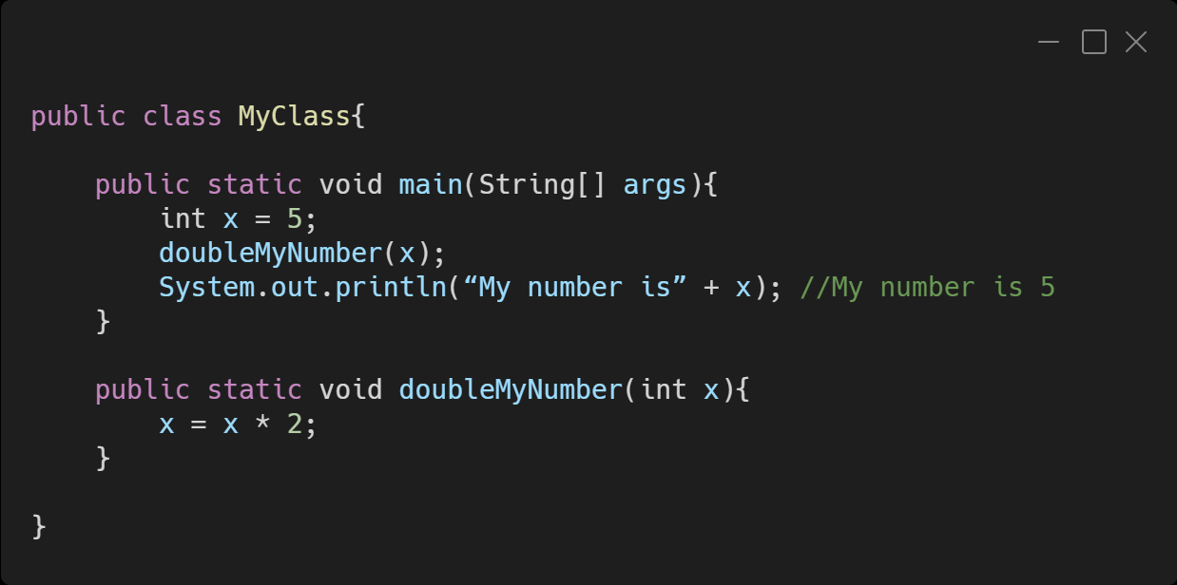
Value semantics
Parameters are passed using call by value or value semantics. Call by value initializes the formal parameters with copies of the actual parameters. When primitives and String are passed as parameters, their values are copied. Modifying the parameter will not affect the variable passed in.
Note: The value of x in main did not change.

Slide 20
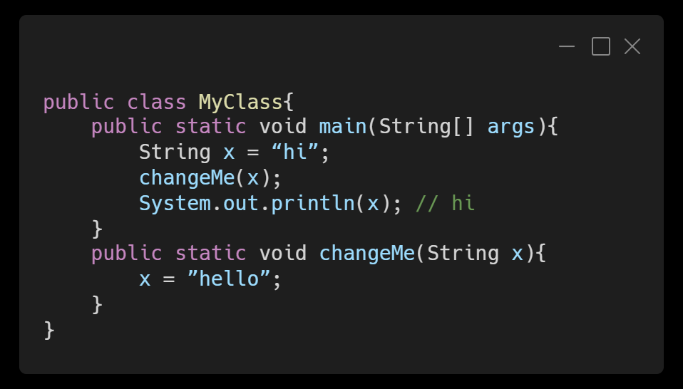
Value semantics
String is the only object class that follows value semantics. Modifying the parameter will not affect the variable passed in.
Note: The value of x in main did not change.

Slide 21
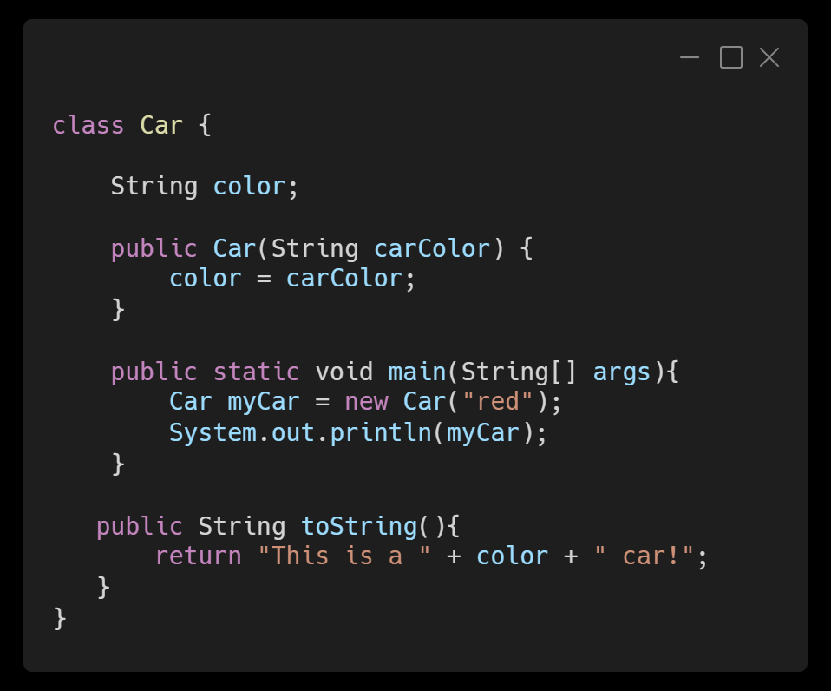
The toString() Method
When we define a toString() method for a class, we can return a String that will print when we print the object:
When this runs, the command System.out.println(myCar) will print This is a red car!, which tells us about the Object myCar.

Slide 22
Practices
indexOf(), compareTo(), substring()

Slide 23
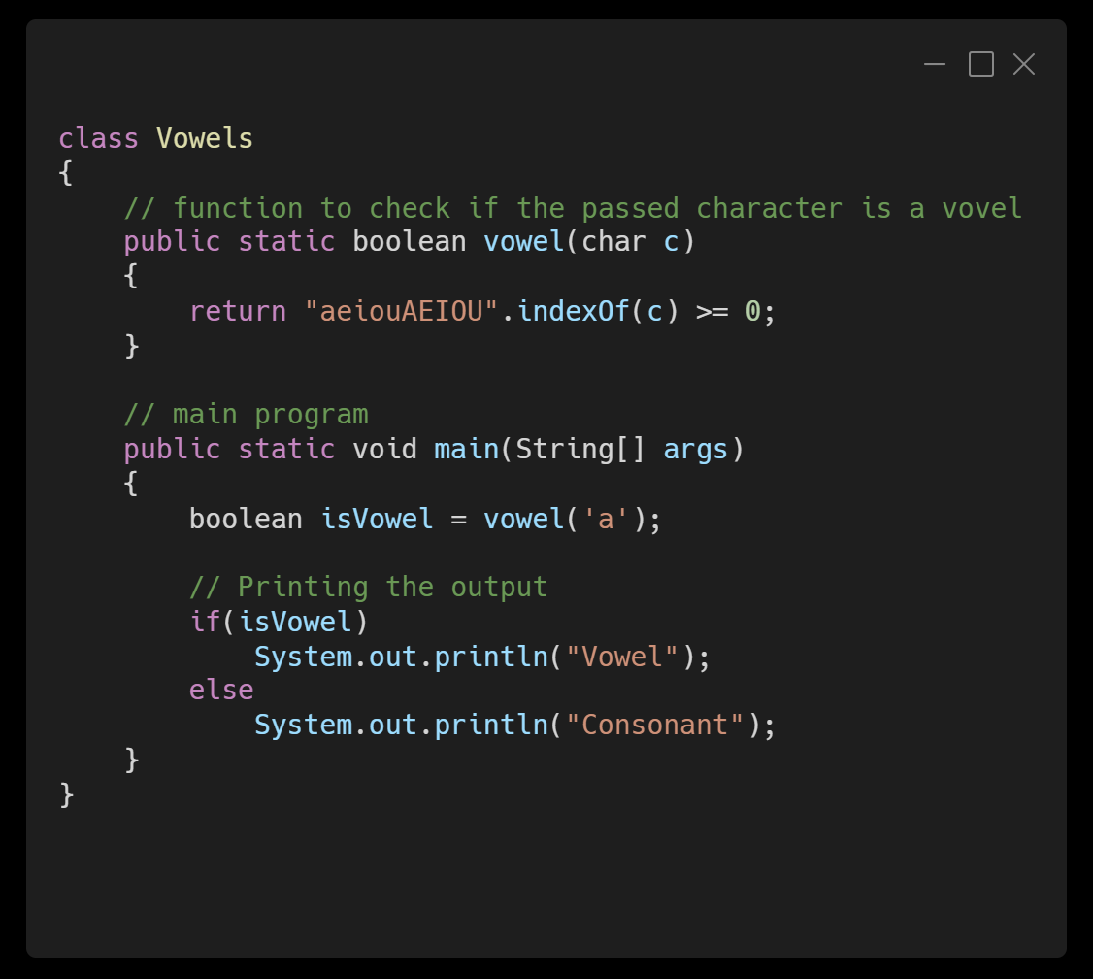
indexOf() Practice
Finding out if a given character (maybe anything upper or lower case) is a vowel or consonant.

Slide 24
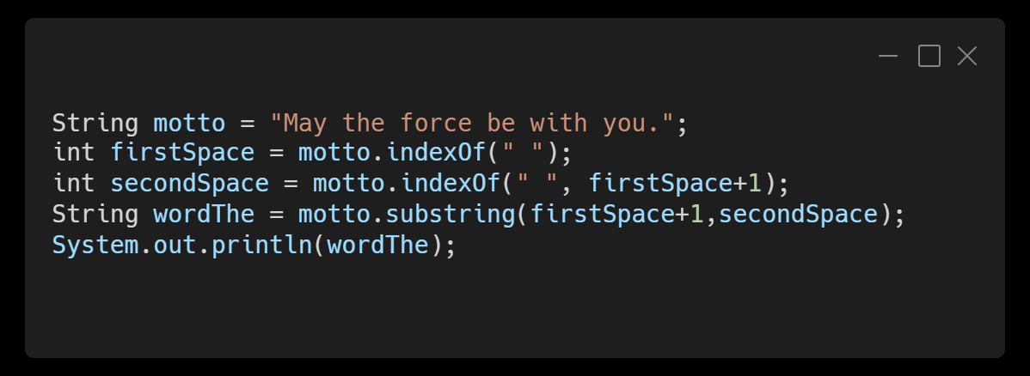
substring() Practice
Extract the word “the” from the following string by finding and using the first and second spaces in the string
String motto = “May the force be with you.”;

Slide 25
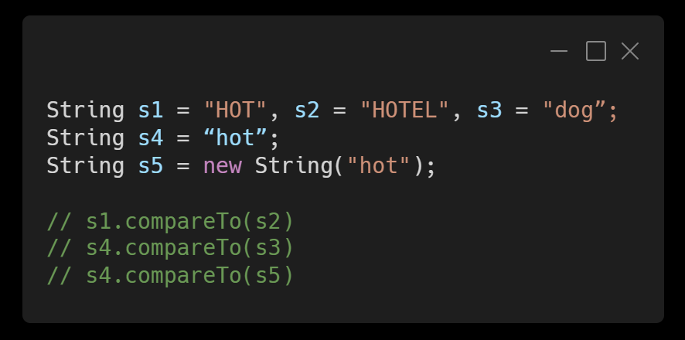
compareTo() Practice
s1.compareTo(s2)
s4.compareTo(s3)
s4.compareTo(s5)

Slide 26
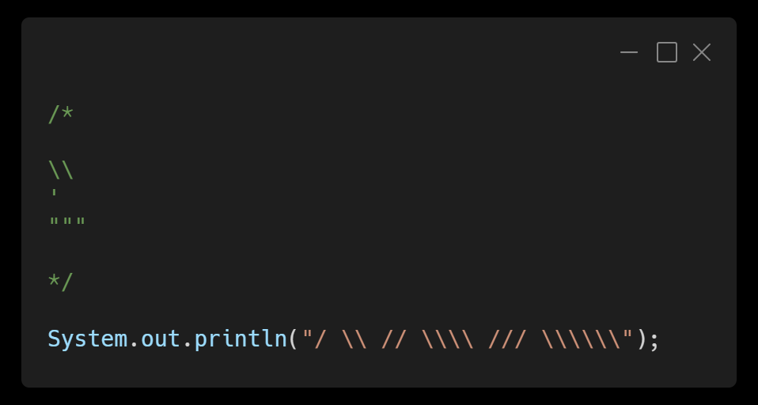
Escape sequence Practice 1
1.
System.out.println("\\\\"); System.out.println("'"); System.out.println("\"\"\"");
2. Write a println statement to produce this output: / \ // \\ /// \\\

Slide 27
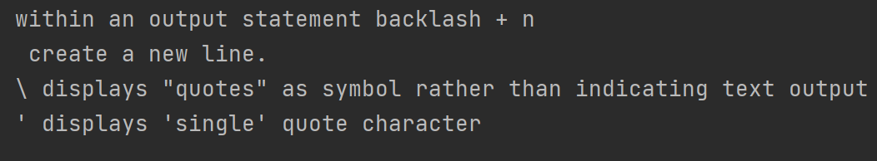
Escape sequence Practice 2
Produce an output shown as the screenshot on the left, using 3 lines of print, it could be of print or println as you wish.
Notes:
System.out.print("within an output statement backlash + n \n create a new line. \n"); System.out.println("\\ displays \"quotes\" as symbol rather than indicating text output"); System.out.println("\' displays \'single\' quote character");

Slide 28
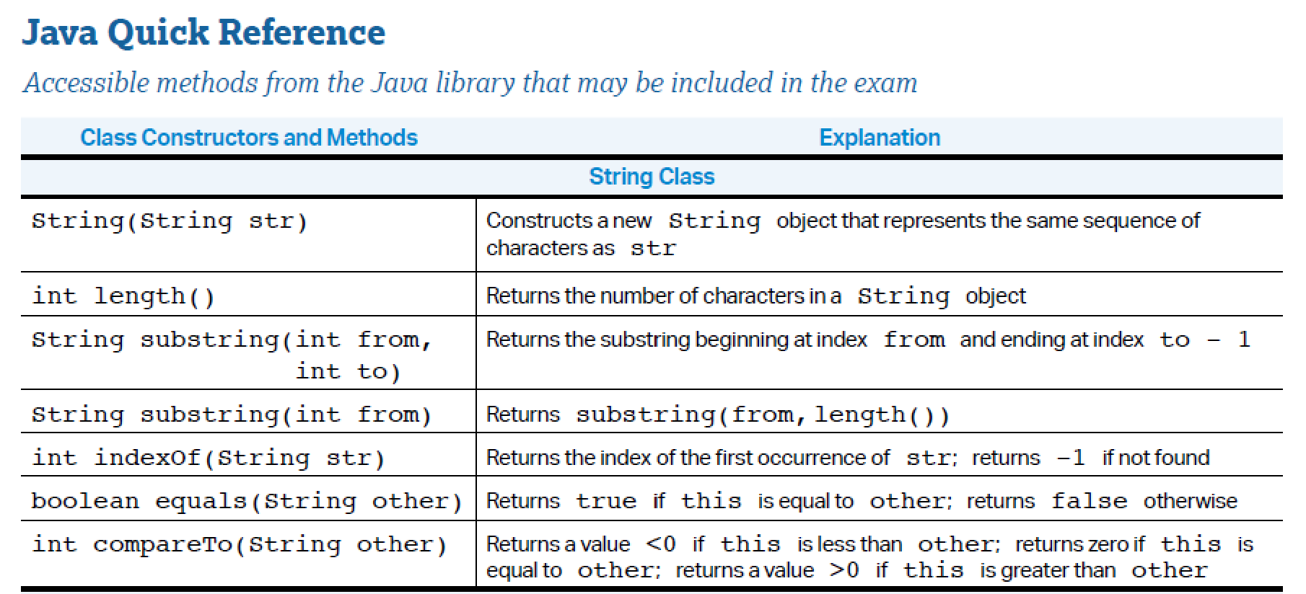

Slide 29
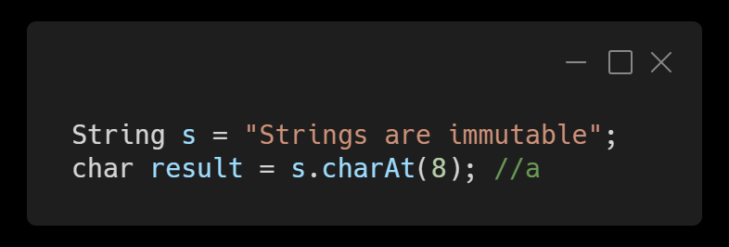
charAt()
Return a value at a requested index

Slide 30
Other String methods
equalsIgnoreCase()
toUpperCase()
toLowerCase()
replace(old, new)
trim() //removes whitespace from both ends of a string

